Slide 1
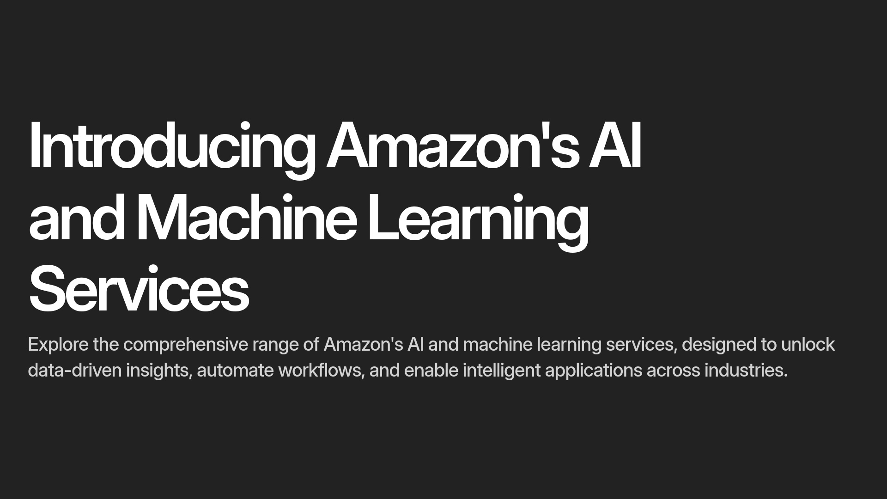

Slide 2
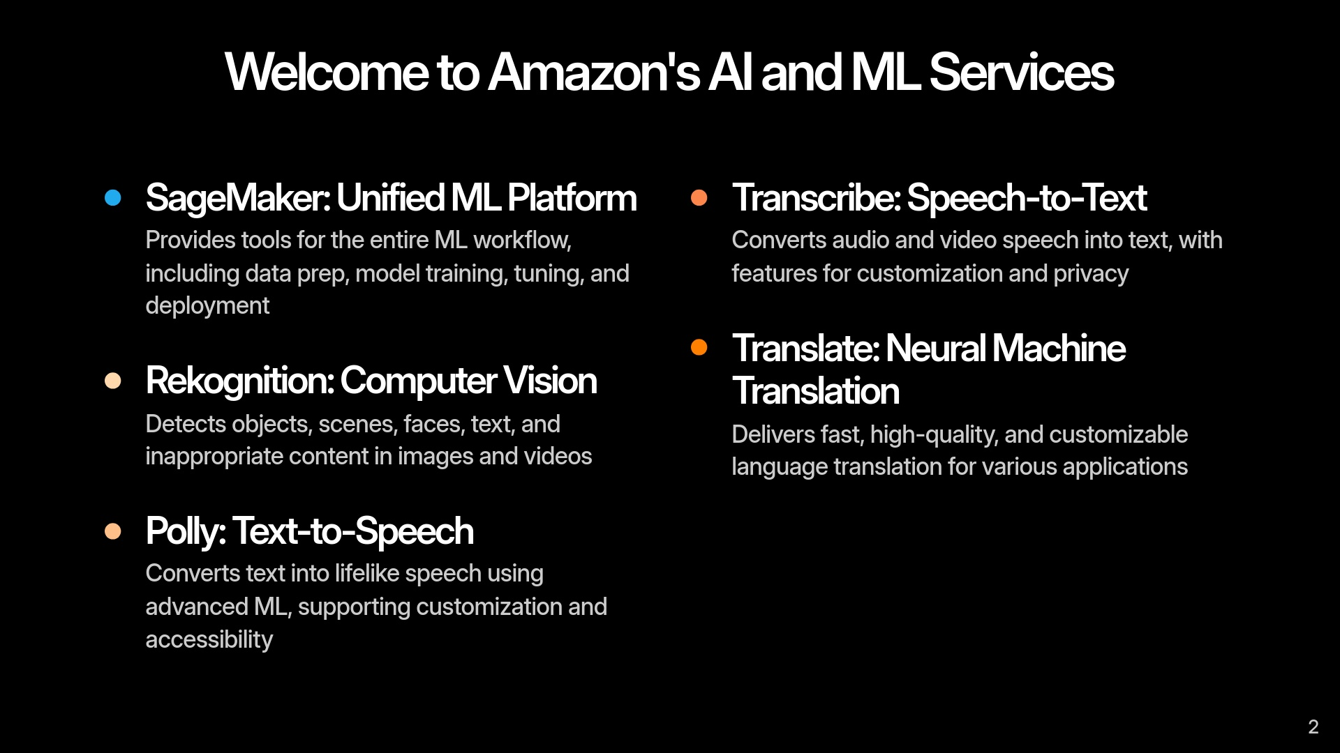

Slide 3
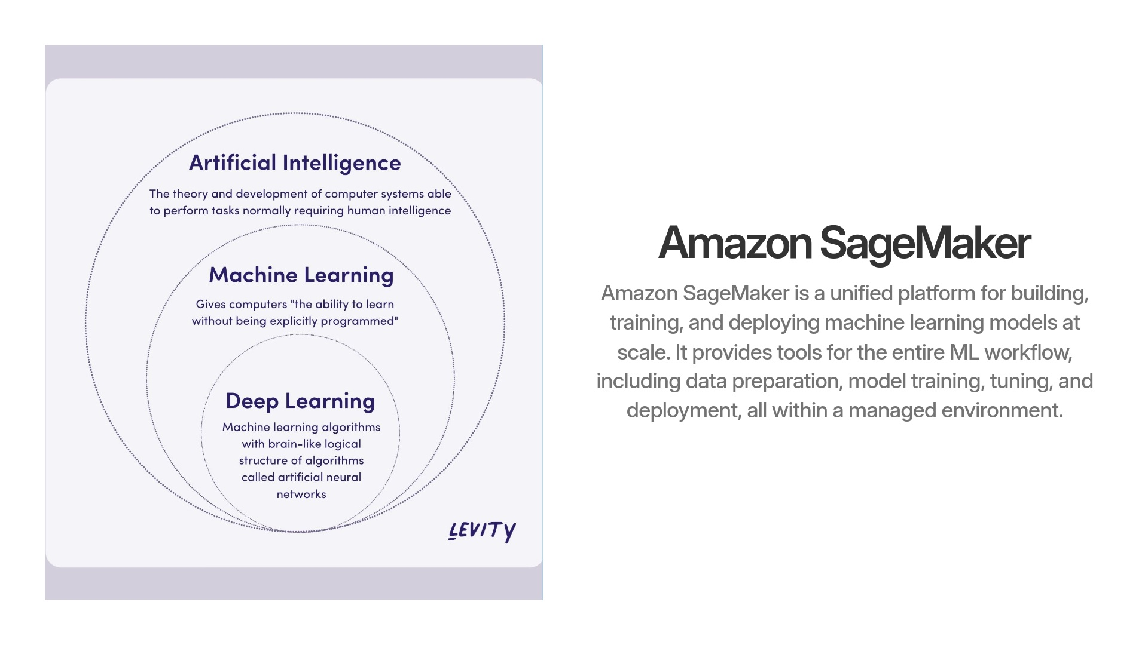
Notes:
Core FeaturesFully managed infrastructure for building, training, and deploying ML models at scale45.Support for both built-in algorithms and custom algorithms (via Docker containers)4.One-click model deployment for fast and easy productionization4.Integration with various AWS services (S3, EC2, EMR, Kinesis, Redshift, CloudWatch)5.Development EnvironmentSageMaker Studio: A web-based IDE for all ML development activities, including notebooks, experiment management, debugging, and model drift detection-all in one visual interfaceData PreparationSageMaker Data Wrangler: Visual tool for data preparation, feature engineering, and cleaning.SageMaker Ground Truth: Data labeling service using human annotators or automated workflowsModel Building and TrainingManaged Jupyter notebooks for scalable, infrastructure-free experimentation.Distributed data parallelism for efficient large-scale deep learning training.Hyperparameter tuning (Automatic Model Tuning) to find the best model configurationAutomation and ProductivitySageMaker Autopilot: Automates building, tuning, and deploying models from tabular dataFeature ManagementSageMaker Feature Store: Centralized repository to store, update, retrieve, and share ML features for both training and inference, ensuring feature consistency and standardization.Model Deployment and ManagementOne-click deployment to production endpoints.SageMaker Model Registry: Centralized model repository for versioning and governance.SageMaker Edge Manager: Manage, optimize, and monitor models on edge devices.SageMaker Neo: Optimizes models for deployment on edge devices without accuracy loss.Workflow OrchestrationSageMaker Pipelines: Managed CI/CD service for automating end-to-end ML workflows4.Monitoring and MaintenanceSageMaker Model Monitor: Detects data drift and model performance degradation in production4.Additional FeaturesLocal Mode: Test and deploy models locally using the SageMaker SDK4.Integration with Spark ML, Scikit-learn, and other ML frameworks1.Support for k-fold validation and other evaluation techniques5.

Slide 4


Slide 5


Slide 6
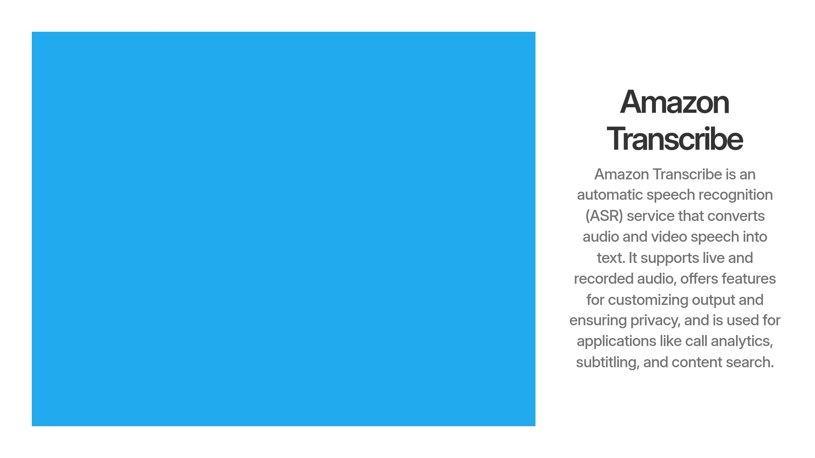
Notes:
AWS Step Functions: Orchestrates the workflow.AWS Lambda: Runs serverless code at each processing step.Amazon S3: Stores audio files.Amazon Transcribe: Converts audio to text.Amazon Comprehend: Extracts entities and key phrases from text.Amazon Elasticsearch Service (Amazon ES): Indexes and stores processed data for search and analytics.Amazon Cognito: Authenticates users.Kibana: Visualizes and builds dashboards from the indexed data.AWS Step Functions is a serverless orchestration service that lets you coordinate multiple AWS services into automated workflows, also known as state machines

Slide 7


Slide 8
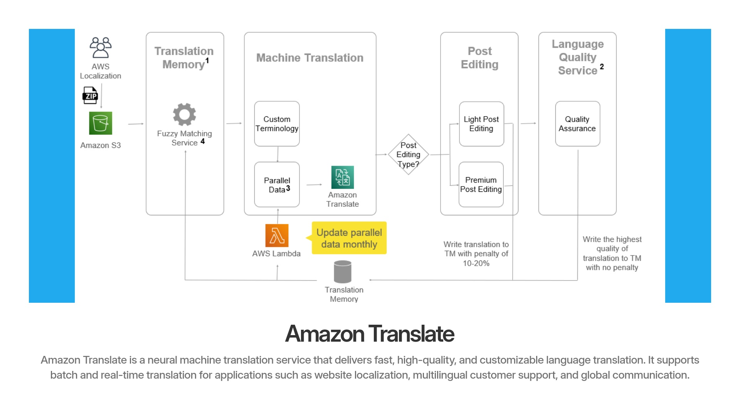
Notes:
Amazon S3: Stores input files for localization.Translation Memory: A database of previously translated content, used for fuzzy matching and improving consistency.Fuzzy Matching Service: Finds similar translations in the translation memory.AWS Lambda: Automates updates, such as updating parallel data monthly.Amazon Translate: Provides machine translation, using custom terminology and parallel data.Post Editing: Human editors improve machine translations, with options for light or premium editing.Language Quality Service: Performs quality assurance to ensure translation quality.Translation Memory (Database): Stores updated translations, tracking quality and penalties for edits.

Slide 9
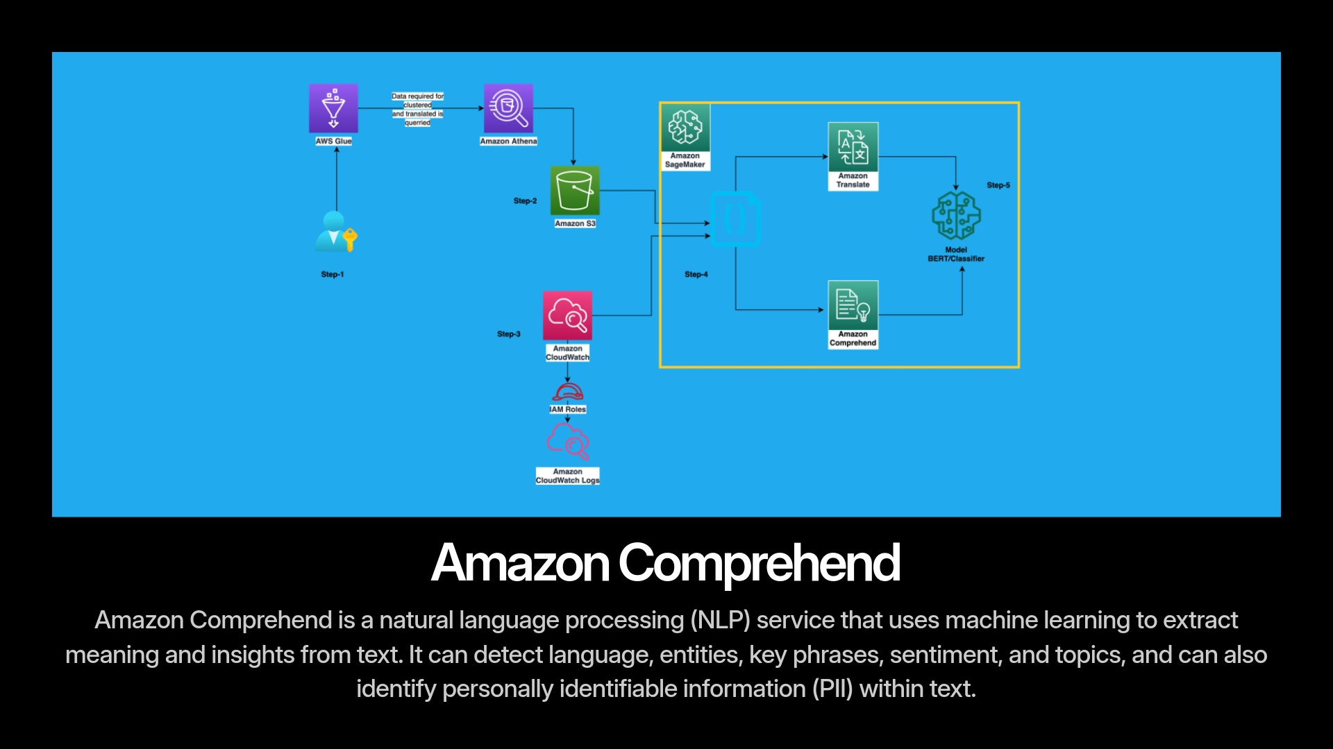

Slide 10


Slide 11
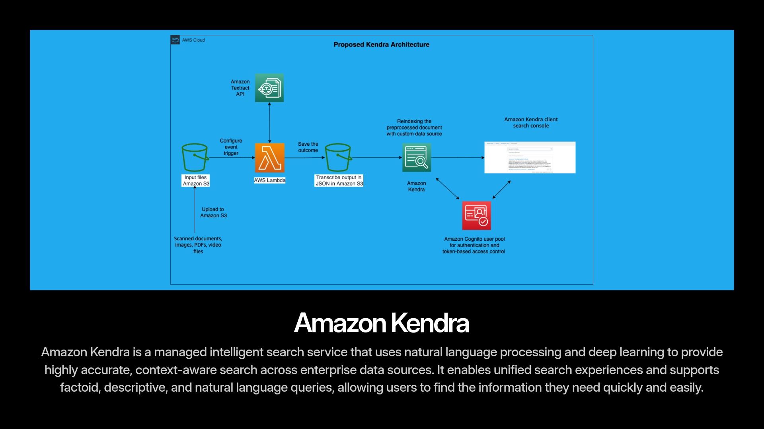

Slide 12
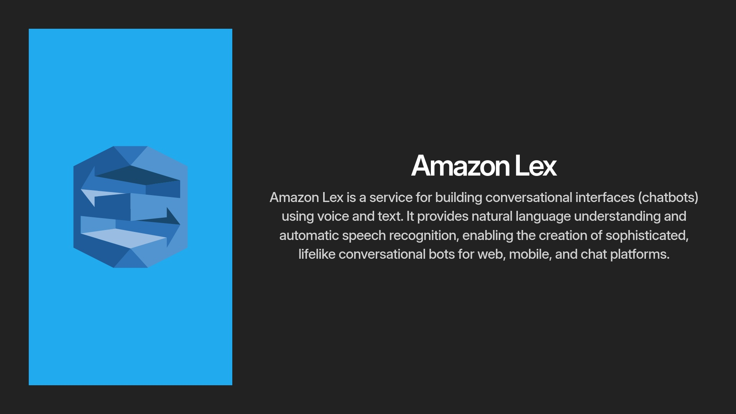

Slide 13


Slide 14
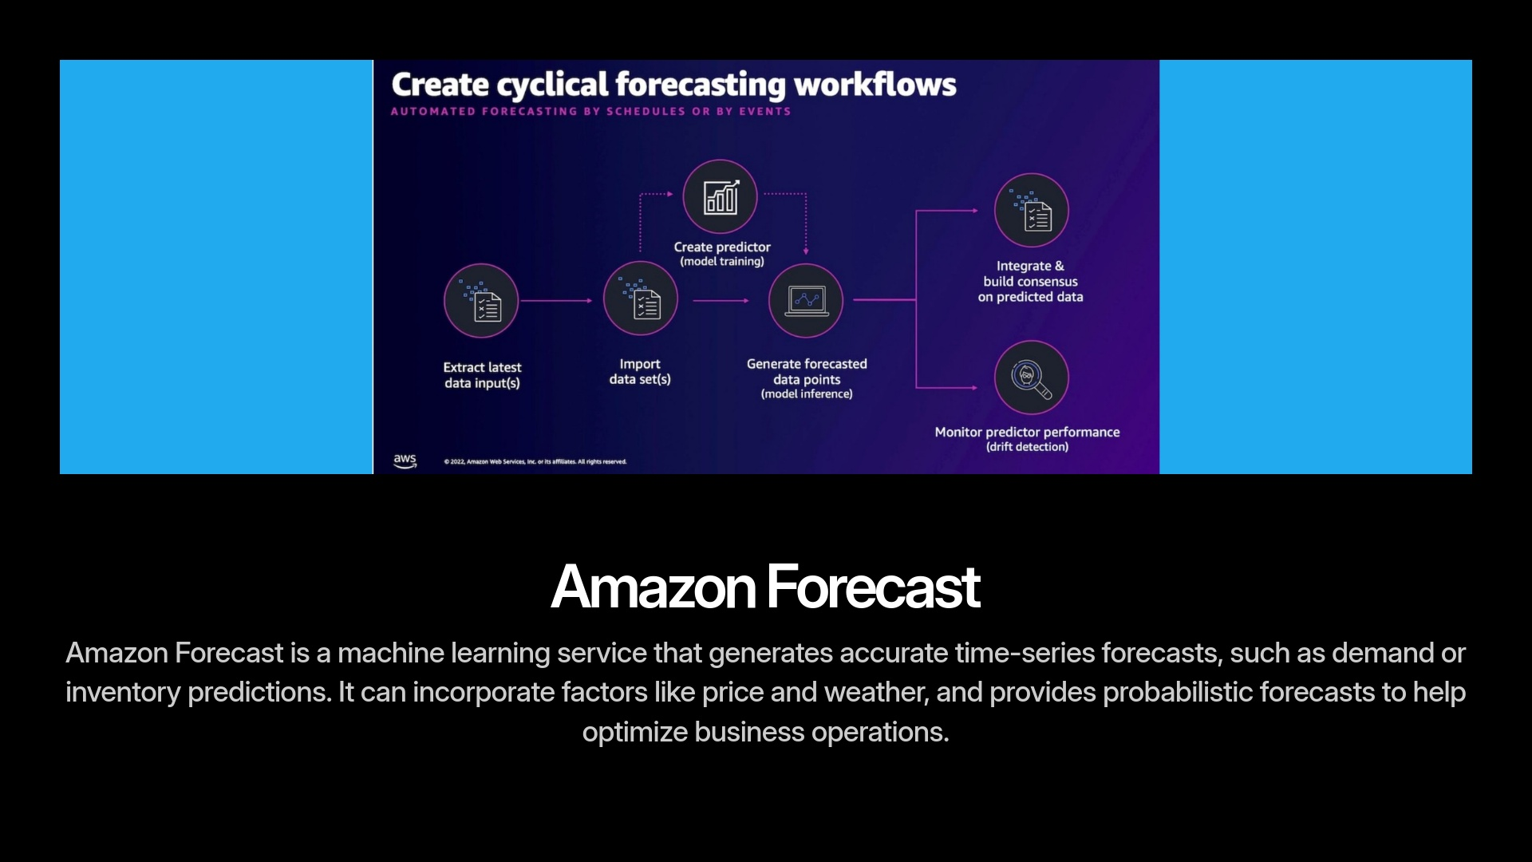

Slide 15
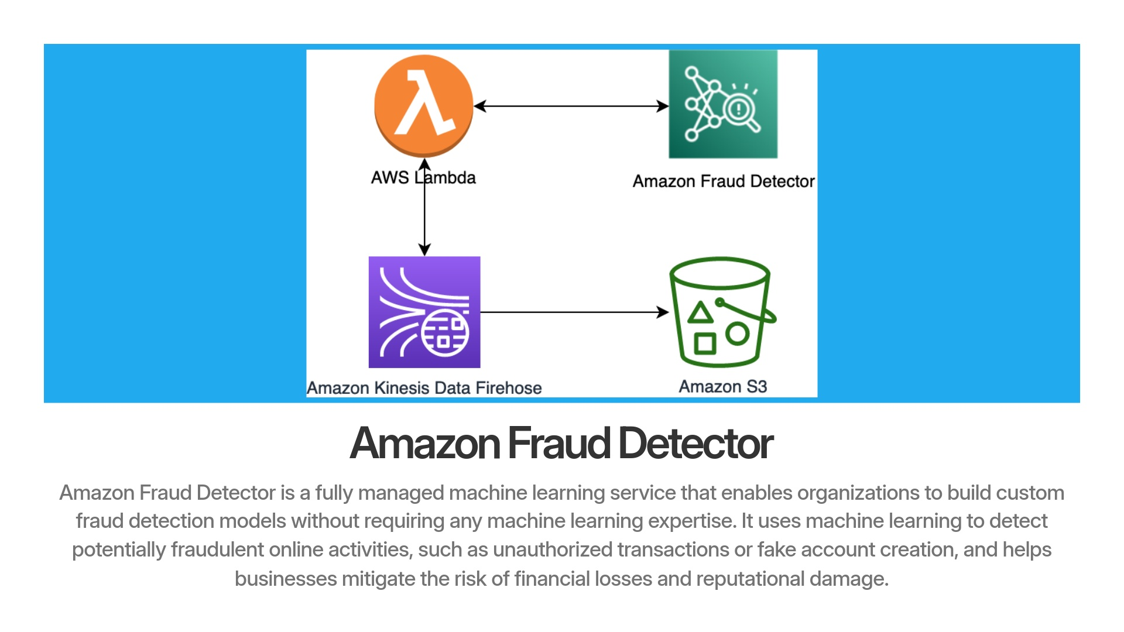

Slide 16
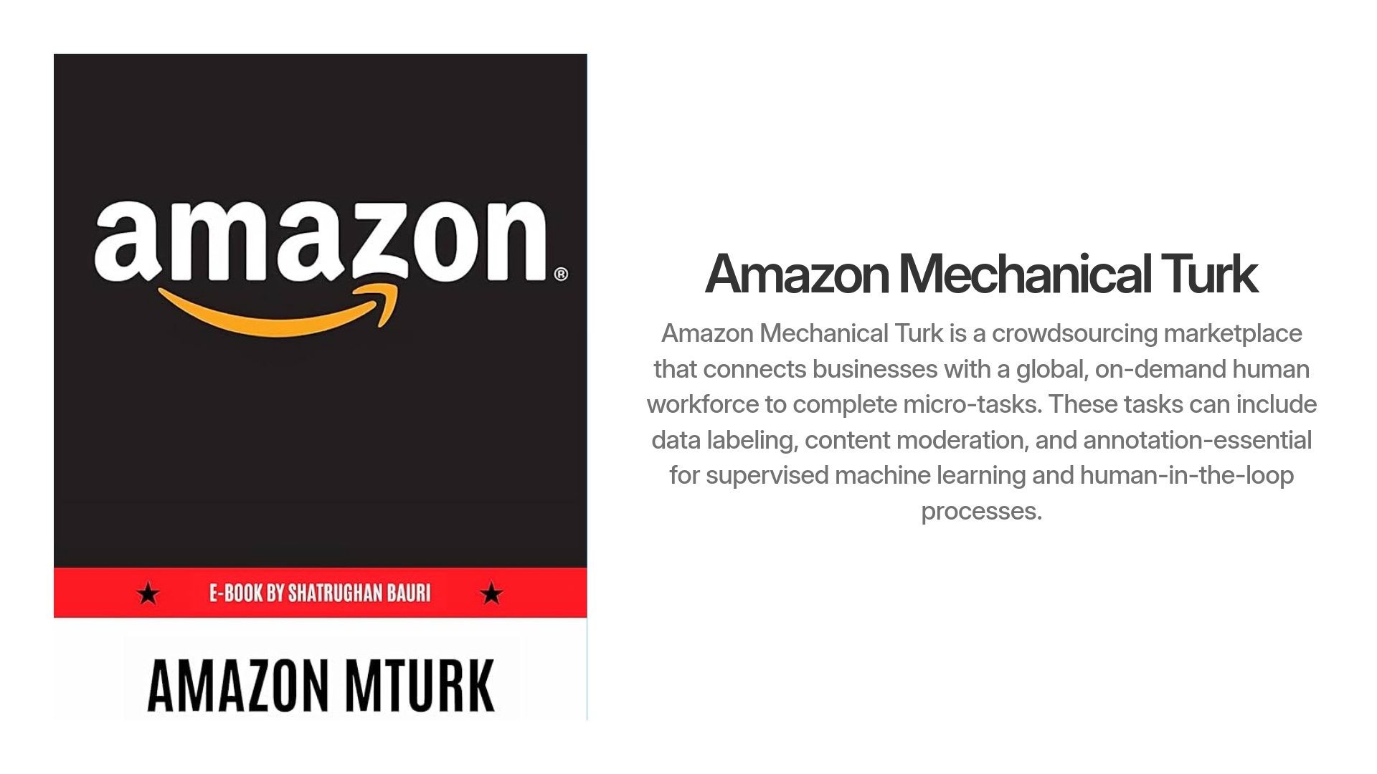

Slide 17
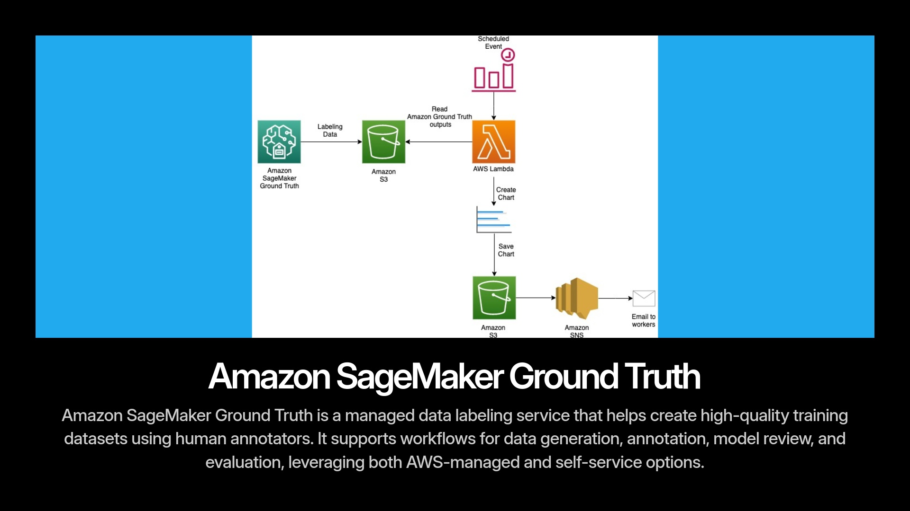

Slide 18
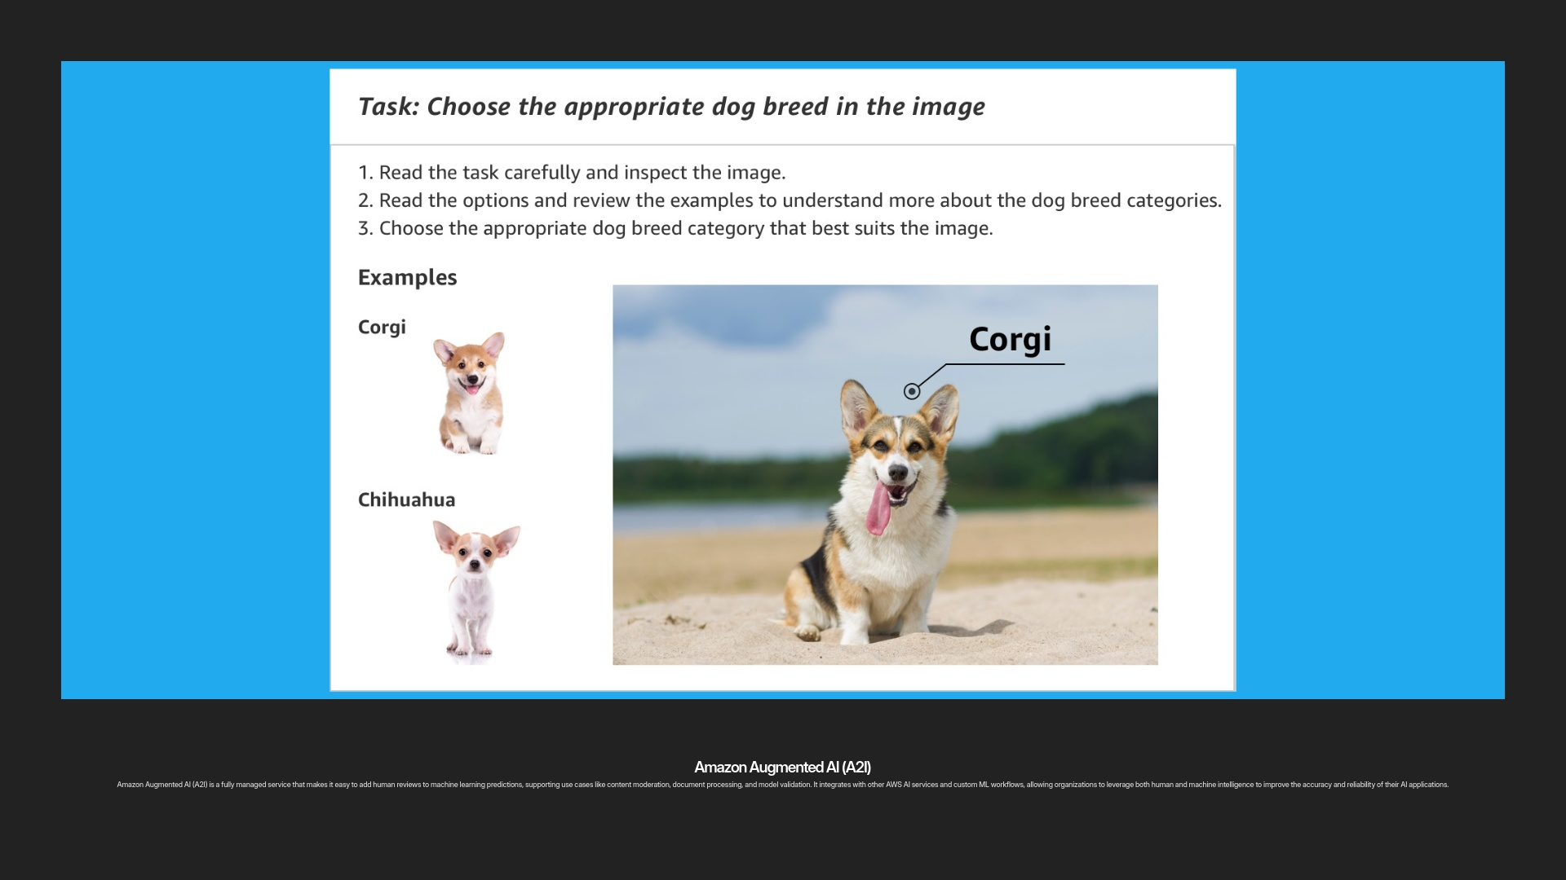

Slide 19
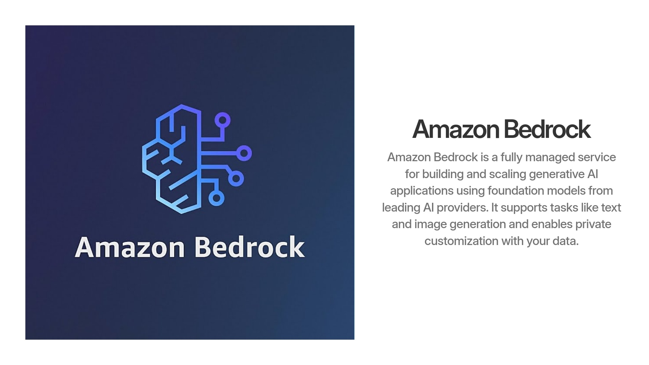

Slide 20
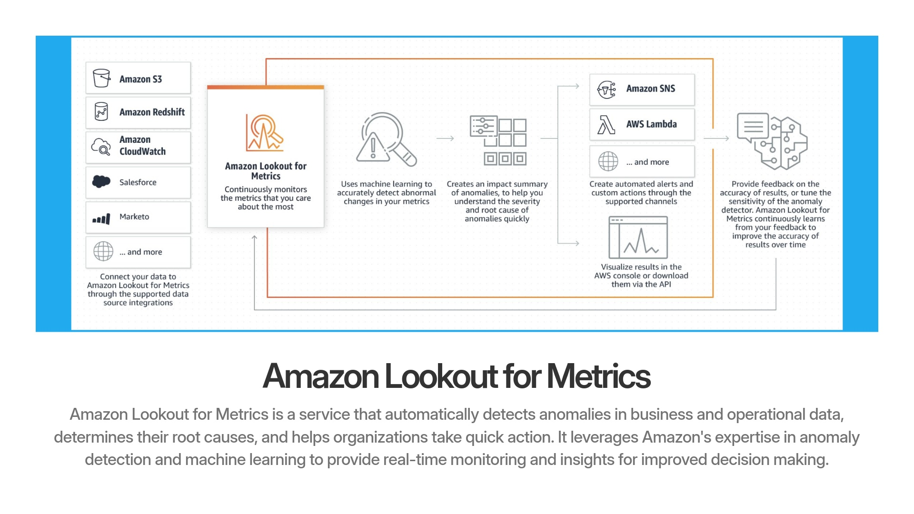

Slide 21
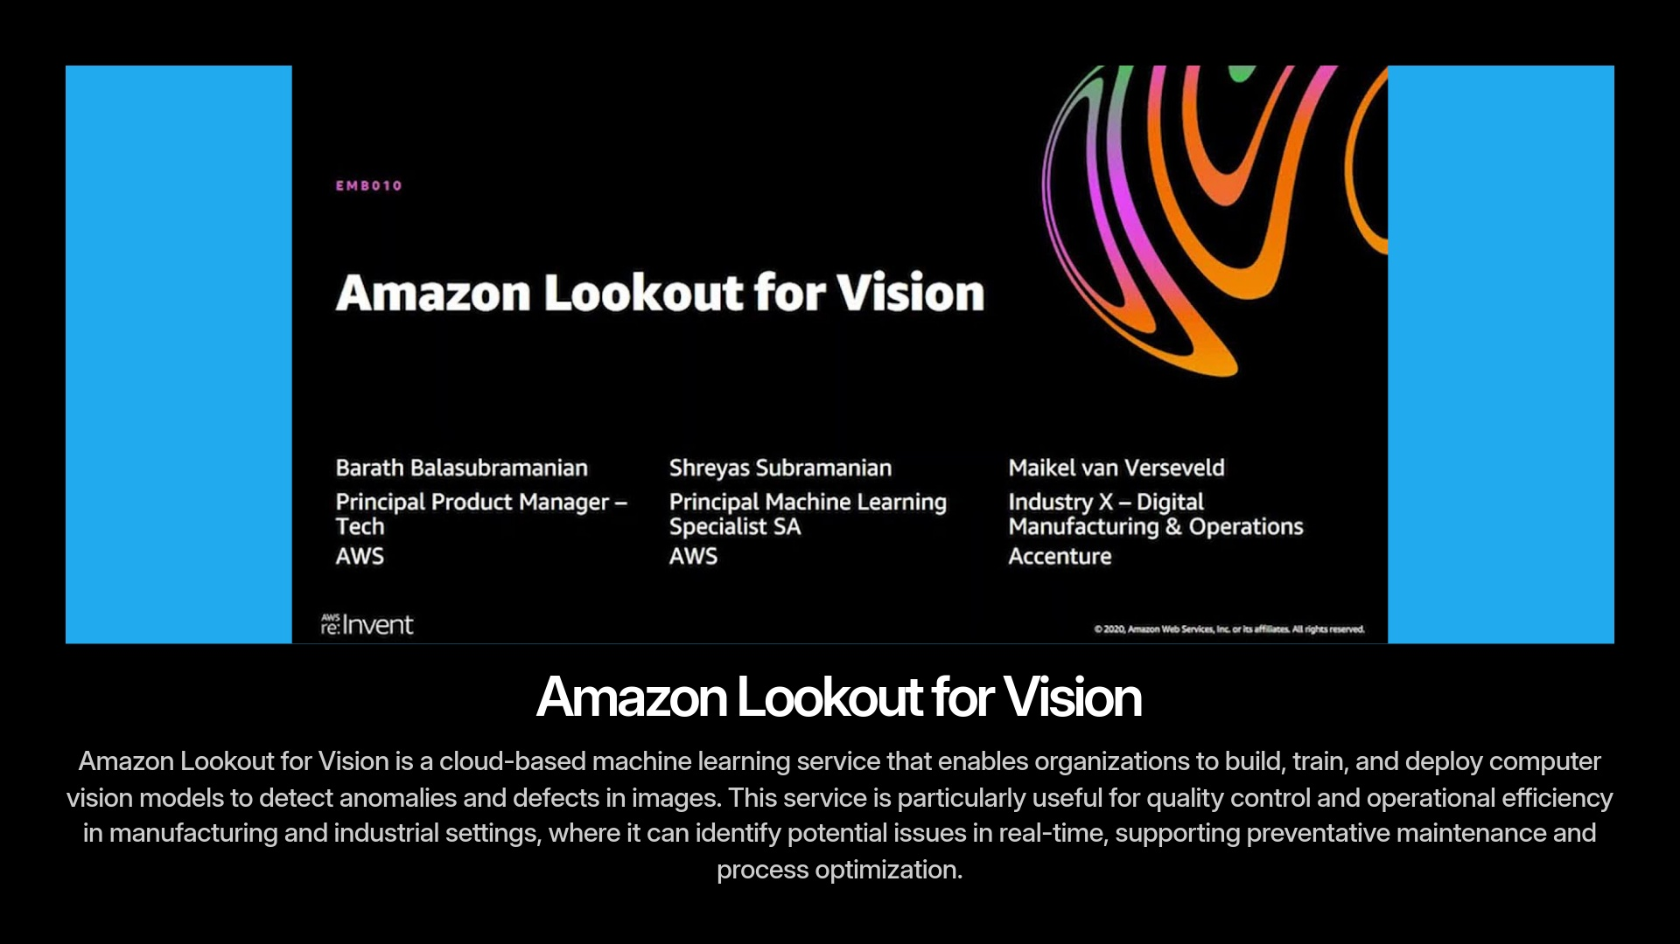

Slide 22
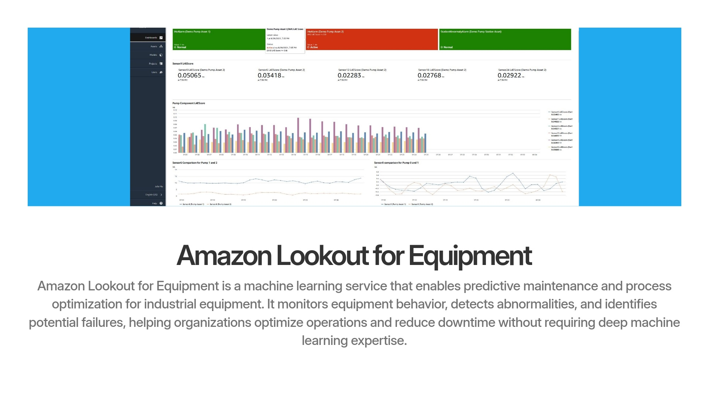

Slide 23
